Slide 1
Chapter 5 : Data Warehouse to Data Mining

Slide 2
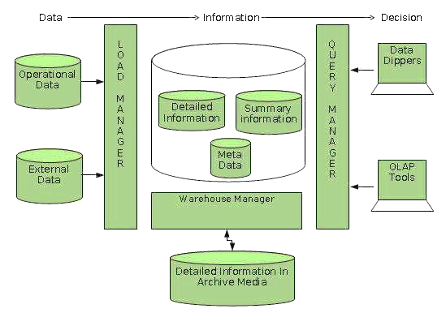
Data Warehouse Architecture

Slide 3
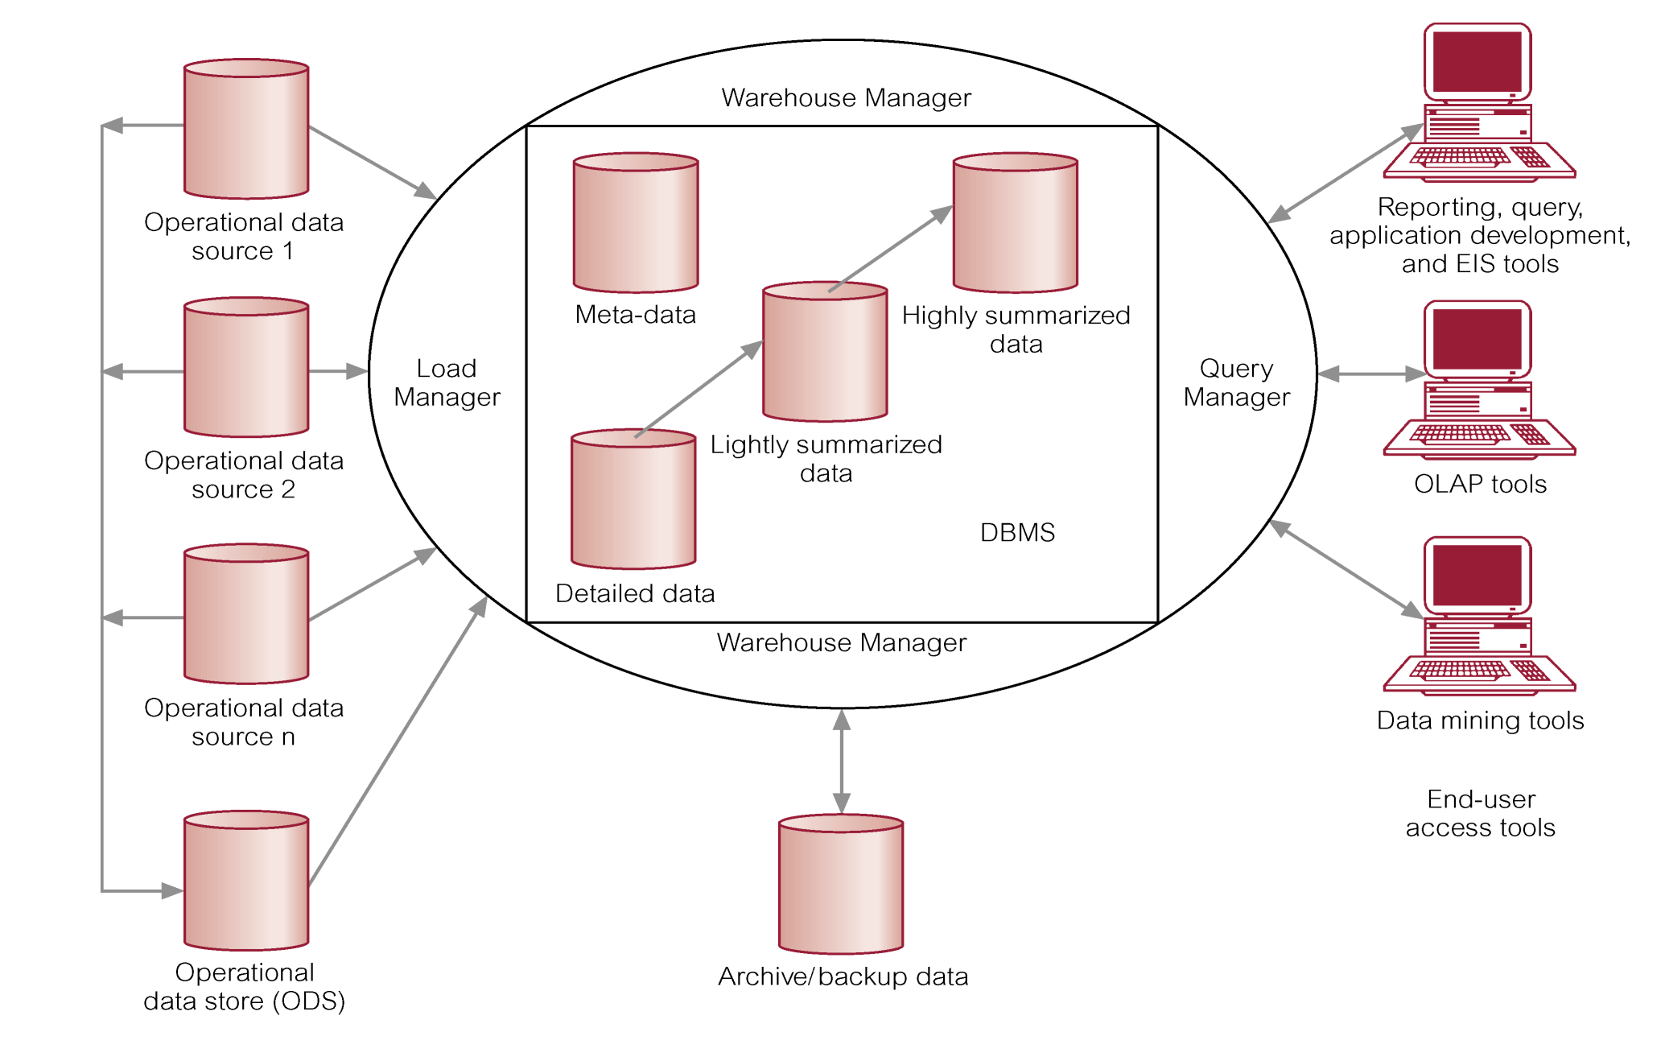
Data Warehouse Architecture

Slide 4
Operational Data Sources: It may include:
Network databases.
Departmental file systems and RDBMSs.
Private workstations and servers.
External systems (Internet, commercially available databases).
Operational Data Store (ODS):
It is a repository of current and integrated operational data used for analysis.
Often structured and supplied with data in same way as DW.

Slide 5
May act simply as staging area for data to be moved into the warehouse.
Provides users with the ease of use of a relational database while remaining distant from decision support functions of the DW.
Load Manager:
Operations include:
perform all the operations necessary to support the extract and load process.
fast load the extracted data into a temporary data store
perform simple transformations into a structure similar to the one in the data warehouse.

Slide 6
Warehouse Manager (Data Manager):
Operations performed include:
Analysis of data to ensure consistency.
Transformation/merging of source data from temp storage into DW
Creation of indexes.
Backing-up and archiving data.
Query Manager (Manages User Queries):
Operations include:
directing queries to the appropriate tables and
scheduling the execution of queries.
In some cases, the query manager also generates query profiles to allow the warehouse manager to determine which indexes and aggregations are appropriate.

Slide 7
Meta Data: This area of the DW stores all the meta-data (data about data) definitions used by all the processes in the warehouse.
Used for a variety of purposes:
Extraction and loading processes
Warehouse management process
Query management process
End-user access tools use meta-data to understand how to build a query.
Most vendor tools for copy management and end-user data access use their own versions of meta-data.

Slide 8
Lightly and Highly Summarized Data:
It stores all the pre-defined lightly and highly aggregated data generated by the warehouse manager.
The purpose of summary info is to speed up the performance of queries.
Removes the requirement to continually perform summary operations (such as sort or group by) in answering user queries.

Slide 9
Archive/Backup Data:
It stores detailed and summarized data for the purposes of archiving and backup.
May be necessary to backup online summary data if this data is kept beyond the retention period for detailed data.
The data is transferred to storage archives such as magnetic tape or optical disk.

Slide 10
End-User Access Tools:
The principal purpose of data warehousing is to provide information to business users for strategic decision-making.
Users interact with the warehouse using end-user access tools.
There are three main groups of access tools:
Data reporting, query tools
Online analytical processing (OLAP) tools
Data mining tools

Slide 11
Design of a Data Warehouse: Three Data Warehouse Models
Enterprise warehouse
collects all of the information about subjects spanning the entire organization
top down approach
the W. Inmon methodology
Data Mart
a subset of corporate-wide data that is of value to a specific groups of users. Its scope is confined to specific, selected groups, such as marketing data mart
Independent vs. dependent (directly from warehouse) data mart
bottom up approach
the R. Kimball methodology
Virtual warehouse
A set of views over operational databases
Only some of the possible summary views may be materialized

Slide 12
The Data Mart Strategy
The most common approach
Begins with a single mart and architected marts are added over time for more subject areas
Relatively inexpensive and easy to implement
Can be used as a proof of concept for data warehousing
Can postpone difficult decisions and activities
Requires an overall integration plan
The key is to have an overall plan, processes, and technologies for integrating the different marts.
The marts may be logically rather than physically separate.

Slide 13
Data Mart is a subset of the information content of a data warehouse that is stored in its own database.
Data mart may or may not be sourced from an enterprise data warehouse i.e. it could have been directly populated from source data.
Data mart can improve query performance simply by reducing the volume of data that needs to be scanned to satisfy the query.
Data marts are created along functional level to reduce the likelihood of queries requiring data outside the mart.
Data marts may help in multiple queries or tools to access data by creating their own internal database structures.
E.g.: Departmental Store, Banking System.

Slide 14
Enterprise Warehouse Strategy
A comprehensive warehouse is built initially
An initial dependent data mart is built using a subset of the data in the warehouse
Additional data marts are built using subsets of the data in the warehouse
Like all complex projects, it is expensive, time consuming, and prone to failure
When successful, it results in an integrated, scalable warehouse
Even with the enterprise-wide strategy, the warehouse is developed in phases and each phase should be designed to deliver business value.

Slide 15
Data Warehouse Development: A Recommended Approach
Multi-Tier Data Warehouse
Distributed Data Marts
Enterprise Data Warehouse
Data Mart
Data Mart
Model refinement
Model refinement
Define a high-level corporate data model

Slide 16
Data mining Architecture:

Slide 17
Major Components:
Database, data warehouse, World Wide Web, or other information repository:
This is one or a set of databases, data warehouses, spreadsheets, or other kinds of information repositories.
Data cleaning and data integration techniques may be performed on the data.
Database or data warehouse server:
The database or data warehouse server is responsible for fetching the relevant data, based on the user’s data mining request.

Slide 18
Knowledge base:
This is the domain knowledge that is used to guide the search or evaluate the interestingness of resulting patterns.
Such knowledge can include concept hierarchies, used to organize attributes or attribute values into different levels of abstraction.
Data mining engine:
This is essential to the data mining system and ideally consists of a set of functional modules for tasks such as characterization, association and correlation analysis, classification, prediction, cluster analysis, outlier analysis, and evolution analysis.

Slide 19
Pattern evaluation module:
This component typically employs interestingness measures and interacts with the data mining modules so as to focus the search toward interesting patterns.
User interface:
This module communicates between users and the data mining system, allowing the user to interact with the system by specifying a data mining query or task, providing information to help focus the search, and performing exploratory data mining based on the intermediate data mining results.

Slide 20
OLAP (Online Analytical Processing) Architecture
The term OLAP or online analytical processing was introduced in a paper entitled "Providing Analytical processing to User Analysts," by Dr. E. R Codd, the acknowledged "father" of the relational database model.

Slide 21
OLAP provides you with a very good view of what is happening, but can not predict what will happen in the future or why it is happening.
OLAP is a term used to describe the analysis of complex data from the data warehouse.
OLAP is an advanced data analysis environment that supports decision making, business modeling, and operations research activities.

Slide 22
Can easily answer ‘who?’ and ‘what?’ questions, however, ability to answer ‘what if?’ and ‘why?’ type questions distinguishes OLAP from general-purpose query tools.
Enables users to gain a deeper understanding and knowledge about various aspects of their corporate data through fast, consistent, interactive access to a wide variety of possible views of the data.
Allows users to view corporate data in such a way that it is a better model of the true dimensionality of the enterprise.

Slide 23
OLAP is a category of applications/technology for Collecting, managing, processing, and presenting multidimensional data for analysis and management purposes.
OLAP is FASMI
Fast
Analysis
Shared
Multidimensional
Information

Slide 24
Main characteristics of OLAP are:
Multidimensional conceptual view
Multi user support
Accessibility
Storing
Uniform reporting performance
Facilitate interactive query and complex analysis for the users.
Provides ability to perform intricate calculations and comparisons.
Presents results in a number of meaningful ways, including charts and graphs.

Slide 25
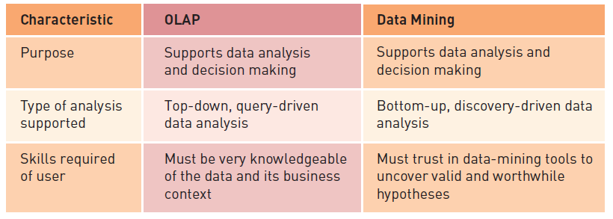
Comparing OLAP and Data Mining

Slide 26
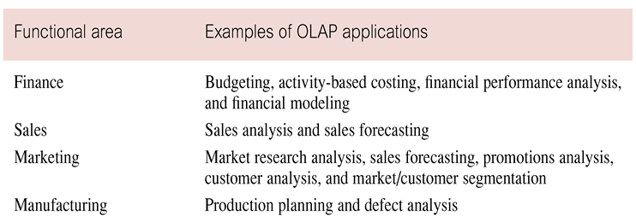
Examples of OLAP Applications in Various Functional Areas

Slide 27
OLAP Benefits
Increased productivity of end-users.
Retention of organizational control over the integrity of corporate data.
Reduced query drag and network traffic on OLTP systems or on the data warehouse.
Improved potential revenue and profitability.

Slide 28
Strengths of OLAP
It is a powerful visualization paradigm
It provides fast, interactive response times
It is good for analyzing time series
It can be useful to find some clusters and outliers
Many vendors offer OLAP tools

Slide 29
OLAP for Decision Support
Goal of OLAP is to support ad-hoc querying for the business analyst
Business analysts are familiar with spreadsheets
Extend spreadsheet analysis model to work with warehouse data
Large data set
Semantically enriched to understand business terms (e.g., time, geography)
Combined with reporting features
Multidimensional view of data is the foundation of OLAP

Slide 30
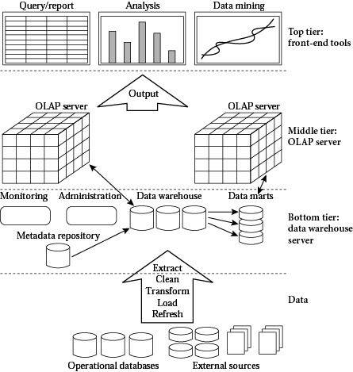
OLAP Architecture

Slide 31
The three-tier architecture includes:
Bottom Tier (Data warehouse server)
Middle Tier (OLAP Server)
Top Tier (Front end tools)
Bottom Tier
The bottom tier is a warehouse database server that is almost always a relational database system.
Data is fed using backend tools and utilities.
Data from operational database and external sources are extracted using application programs interfaces known as gateways.
Examples of gateways include ODBC (Open database connection) and OLE-DB (Open linking and embedding for databases), by Microsoft, and JDBC (Java Database Connection).

Slide 32
Middle Tier
The middle tier is an OLAP server that is typically implemented using either:
A Relational OLAP(ROLAP) model, that is, an extended relational DBMS that maps operations on multidimensional data to standard relational operations; or
A Multidimensional PLAP (MOLAP) model, that is, a special-purpose server that directly implements multidimensional data and operations.
Top Tier
The top tier is a front-end client layer, which contains query and reporting tools, analysis tools, and/or data mining tools (e.g. trend analysis, prediction and so on).

Slide 33
OLAP Architecture (continued)
Designed to use both operational and data warehouse data
Defined as an “advanced data analysis environment that supports decision making, business modeling, and an operation’s research activities”
In most implementations, data warehouse and OLAP are interrelated and complementary environments

Slide 34
OLTP (Online Transaction Processing)
OLTP is characterized by a large number of short online transactions (INSERT, UPDATE and DELETE).
OLTP is used to carry out day to day business functions such as ERP (Enterprise Resource Planning), CRM (Customer Relationship Planning).
OLTP system solved a critical business problem of automating daily business functions and running real time report and analysis.

Slide 35
OLTP Vs OLAP
Facts/Characteristics | OLTP | OLAP
Source of Data | Operational Data | Data warehouse (From various database)
Purpose of data | Control and run fundamental business tasks | For planning, problem solving and decision support
Queries | Simple queries | Complex queries and algorithms
Processing Speed | Typically, very fast | Depends on data size, techniques and algorithms
Space requirements | Can be relatively small | Larger due to aggregated databases
Database Design | Highly Normalized with many tables. ER based, application-oriented. | Typically, de-normalized with fewer tables. Use of star or snowflake schema, subject-oriented.
Characteristics | Operational processing | Information processing
Orientation | Transaction | Analysis

Slide 36
OLAP Vs OLTP
Nature of User | Operations workers (e.g. Clerk, DBA, Database professionals) | Knowledge Workers, Decision makers (e.g. manager, executive, analyst)
Functions | Day-to-day operations | Long-term informational requirements, decision support.
Data | Current, detailed, relational; guaranteed up to date | Historical, summarized, multidimensional; accuracy maintained over time
Unit of Work | Short, simple transaction | Complex query
Focus | Data in | Information out
Number of users | Thousands | Hundreds
DB Size | 100M to GB | 100GB to TB
View | Detailed, flat relational | Summarized, multidimensional
Access | Read/ Write | Mostly read
Updates | All the time | Usually not allowed

Slide 37
On-Line Analytical Mining (OLAM)
On-line analytical mining (OLAM) (also called OLAP mining) integrates on-line analytical processing (OLAP) with data mining and mining knowledge in multidimensional databases.
OLAM is particularly important for the following reasons:
High quality of data in data warehouses
Available information processing infrastructure surrounding data warehouses
OLAP-based exploratory data analysis
On-line selection of data mining functions

Slide 38
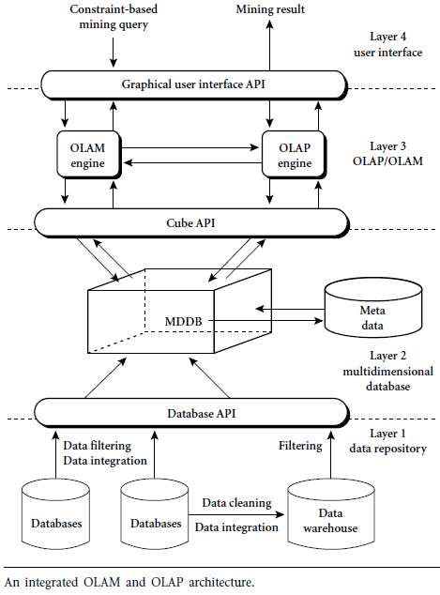
Figure

Slide 39
An OLAM server performs analytical mining in data cubes in a similar manner as an OLAP server performs on-line analytical processing.
An integrated OLAM and OLAP architecture is shown in figure above, where the OLAM and OLAP servers both accept user on-line queries (or commands) via a graphical user interface API and work with the data cube in the data analysis via a cube API.

Slide 40
A metadata directory is used to guide the access of the data cube.
The data cube can be constructed by accessing and/or integrating multiple databases via an MDDB API and/or by filtering a data warehouse via a database API that may support OLE DB or ODBC connections.

Slide 41
Server Options
Single processor (Uniprocessor)
Symmetric multiprocessor (SMP)
Massively parallel processor (MPP)

Slide 42
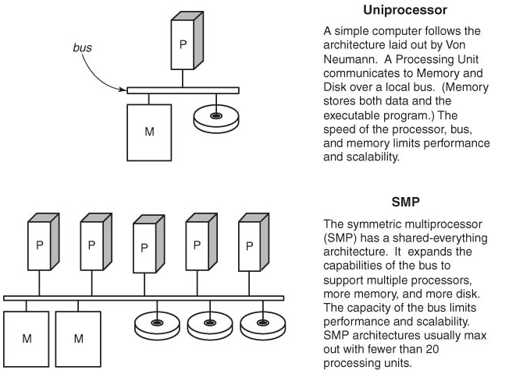
Server Options

Slide 43
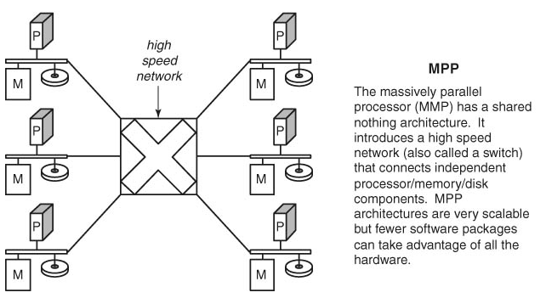
Server Options

Slide 44
OLAP Server Options/Categories of OLAP Tools
OLAP tools are categorized according to the architecture of the underlying database.
Three main categories of OLAP tools includes:
Relational OLAP (ROLAP)
Multi-dimensional OLAP (MOLAP or MD-OLAP)
DOLAP (Desktop OLAP)
Hybrid OLAP (HOLAP )

Slide 45
Relational OLAP (ROLAP)
Relational OLAP (ROLAP) implementations are similar in functionality to MOLAP.
However, these systems use an underlying RDBMS, rather than a specialized MDDB.
This gives them better scalability since they are able to handle larger volumes of data than the MOLAP architectures.
Also, ROLAP implementations typically have better drill-through because the detail data resides on the same database as the multidimensional data .

Slide 46
Relational OLAP (ROLAP)
The ROLAP environment is typically based on the use of a data structure known as a star or snowflake schema.
Analogous to a virtual MDDB, a star or snowflake schema is a way of representing multidimensional data in a two-dimensional RDBMS.
The data modeler builds a fact table, which is linked to multiple dimension tables.
The dimension tables consist almost entirely of keys, such as location, time, and product, which point back to the detail records stored in the fact table.

Slide 47
This type of data structure requires a great deal of initial planning and set up, and suffers from some of the same operational and flexibility concerns of MDDBs.
Additionally, since the data structures are relational, SQL must be used to access the detail records.
Therefore, the ROLAP engine must perform additional work to do comparisons, such as comparing the current quarter with this quarter last year.
Again, IT must be heavily involved in defining, implementing, and maintaining the database.
Furthermore, the ROLAP architecture often restricts the user from performing OLAP operations in a mobile environment

Slide 48
Relational Online Analytical Processing (ROLAP)
OLAP functionality using relational database and familiar query tools to store and analyze multidimensional data
Adds following extensions to traditional RDBMS:
Multidimensional data schema support within RDBMS
Data access language and query performance optimized for multidimensional data
Support for Very Large Databases
Tune a relational DBMS to support star schemas.
Frontend
Tool
MD-Interface
ROLAP-
Engine
Meta Data
SQL
Relational DB

Slide 49
ROLAP is a fastest growing style of OLAP technology.
Supports RDBMS products using a metadata layer - avoids need to create a static multi-dimensional data structure - facilitates the creation of multiple multi-dimensional views of the two-dimensional relation.
To improve performance, some products use SQL engines to support complexity of multi-dimensional analysis, while others recommend, or require, the use of highly denormalized database designs such as the star schema.

Slide 50
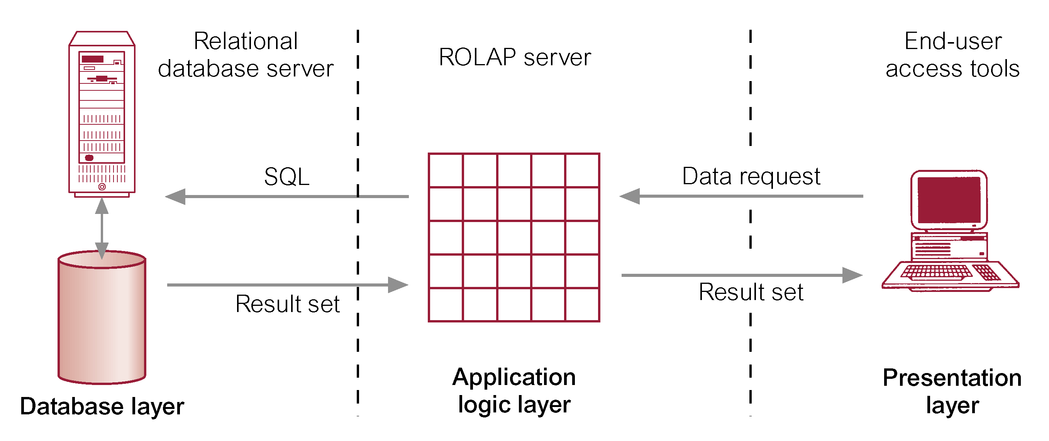
Typical Architecture for ROLAP Tools

Slide 51
With ROLAP data remains in the original relational tables, a separate set of relational tables is used to store and reference aggregation data. ROLAP is ideal for large databases or legacy data that is infrequently queried.
ROLAP Products:
IBM DB2, Oracle, Sybase IQ, RedBrick, Informix
ROLAP Tools
ORACLE 8i
ORACLE Reports; ORACLE Discoverer
ORACLE Warehouse Builder
Arbors Software’s Essbase

Slide 52
Advantages of ROLAP
Define complex, multi-dimensional data with simple model
Reduces the number of joins a query has to process
Allows the data warehouse to evolve with rel. low maintenance
HOWEVER! Star schema and relational DBMS are not the magic solution
Query optimization is still problematic

Slide 53
Features of ROLAP:
Ask any question (not limited to the contents of the cube)
Ability to drill down
Downsides of ROLAP:
Slow Response
Some limitations on scalability

Slide 54
Multi-Dimensional OLAP (MOLAP)
The first generation of server-based multidimensional OLAP (MOLAP) solutions use multidimensional databases (MDDBs).
The main advantage of an MDDB over an RDBMS is that an MDDB can provide information quickly since it is calculated and stored at the appropriate hierarchy level in advance.
However, this limits the flexibility of the MDDB since the dimensions and aggregations are predefined.

Slide 55
Multi-Dimensional OLAP (MOLAP)
If a business analyst wants to examine a dimension that is not defined in the MDDB, a developer needs to define the dimension in the database and modify the routines used to locate and reformat the source data before an operator can load the dimension data.
Another important operational consideration is that the data in the MDDB must be periodically updated to remain current.

Slide 56
This update process needs to be scheduled and managed. In addition, the updates need to go through a data cleansing and validation process to ensure data consistency.
Finally, an administrator needs to allocate time for creating indexes and aggregations, a task that can consume considerable time once the raw data has been loaded.
These requirements also apply if the company is building a data warehouse that is acting as a source for the MDDB.

Slide 57
Organizations typically need to invest significant resources in implementing MDDB systems and monitoring their daily operations.
This complexity adds to implementation delays and costs, and requires significant IT involvement.
This also results in the analyst, who is typically a business user, having a greater dependency on IT.
Thus, one of the key benefits of this OLAP technology — the ability to analyze information without the use of IT professionals — may be significantly diminished.

Slide 58
Uses specialized data structures and multi-dimensional Database Management Systems (MD-DBMSs) to organize, navigate, and analyze data.
Use a specialized DBMS with a model such as the “data cube.”
Data is typically aggregated and stored according to predicted usage to enhance query performance.
Front-end
Tool
Multidimensional
Database

Slide 59
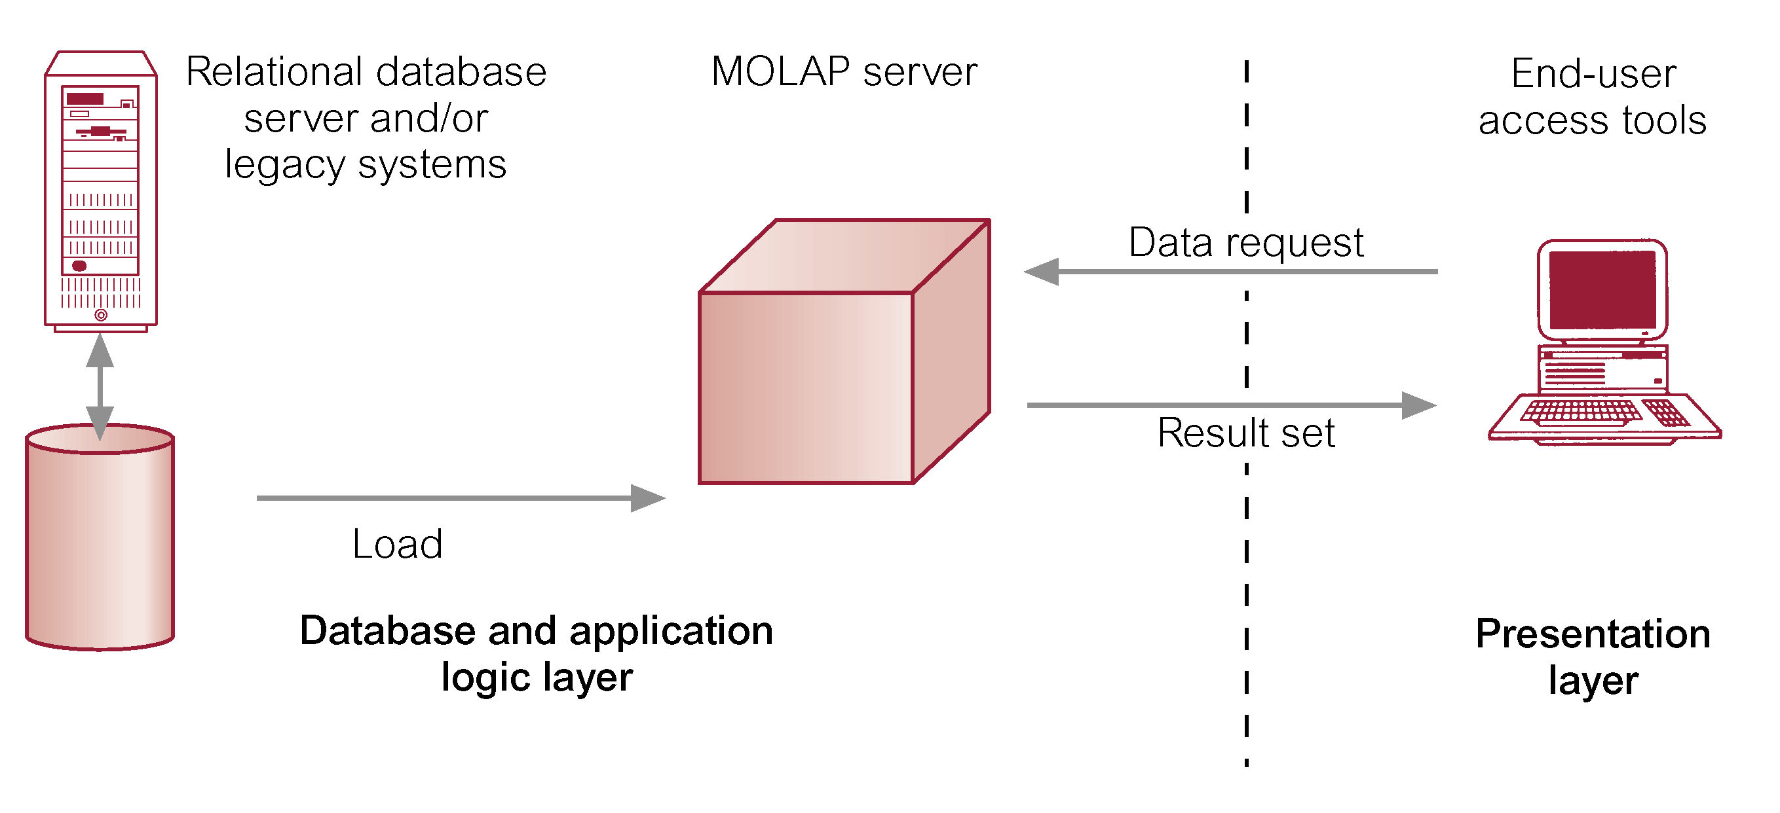
Typical Architecture for MOLAP Tools

Slide 60
Traditionally, require a tight coupling with the application layer and presentation layer.
Recent trends segregate the OLAP from the data structures through the use of published application programming interfaces (APIs).
MOLAP Products
Pilot, Arbor Essbase, Gentia
MOLAP Tools
ORACLE Express Server
ORACLE Express Clients (C/S and Web)
MicroStrategy’s DSS server
Platinum Technologies’ Plantinum InfoBeacon

Slide 61
Use array technology and efficient storage techniques that minimize the disk space requirements through sparse data management.
Provides excellent performance when data is used as designed, and the focus is on data for a specific decision-support application.
Features:
Very fast response
Ability to quickly write data into the cube
Downsides:
Limited Scalability
Inability to contain detailed data
Load time

Slide 62
Desktop OLAP (or Client OLAP)
The desktop OLAP market resulted from the need for users to run business queries using relatively small data sets extracted from production systems.
Most desktop OLAP systems were developed as extensions of production system report writers, while others were developed in the early days of client/server computing to take advantage of the power of the emerging (at that time) PC desktop.
Desktop OLAP systems are popular and typically require relatively little IT investment to implement. They also provide highly mobile OLAP operations for users who may work remotely or travel extensively.
However, most are limited to a single user and lack the ability to manage large data sets.

Slide 63
Client-
OLAP
proprietary data structure on the client
data stored as file
mostly RAM based architectures
mobile user
ease of installation and use
data volume
no multiuser capabilities
Stores in the form of cubes/micro-cubes on the desktop/client machine
Products:
Brio.Enterprise
BusinessObjects
Cognos PowerPlay

Slide 64
Hybrid OLAP (HOLAP)
Hybrid OLAP (HOLAP) combines ROLAP and MOLAP storage.
It tries to take advantage of the strengths of each of the other two architectures, while minimizing their weaknesses.
Some vendors provide the ability to access relational databases directly from an MDDB, giving rise to the concept of hybrid OLAP environments.
This implements the concept of "drill through," which automatically generates SQL to retrieve detail data records for further analysis.

Slide 65
Hybrid OLAP (HOLAP)
This gives end users the perception they are drilling past the multidimensional database into the source database.
The hybrid OLAP system combines the performance and functionality of the MDDB with the ability to access detail data, which provides greater value to some categories of users.
However, these implementations are typically supported by a single vendor’s databases and are fairly complex to deploy and maintain.
Additionally, they are typically somewhat restrictive in terms of their mobility.

Slide 66
Can use data from either a RDBMS directly or a multi-dimension server.
Equal treatment of MD and Relational Data
Storage type at the discretion of the administrator
Cube Partitioning
HOLAP System
Meta Data
Multidimensional Storage
Relational Storage

Slide 67
HOLAP combines elements from MOLAP and ROLAP.
HOLAP keeps the original data in relational tables but stores aggregations in a multidimensional format.
Combines MOLAP & ROLAP
Utilizes both pre-calculated cubes & relational data sources
HOLAP Tools
ORACLE 8i
ORACLE Express Serve
ORACLE Relational Access Manager
ORACLE Express Clients (C/S and Web)
HOLAP Products:
Oracle Express
Seagate Holos
Speedware Media/M
Microsoft OLAP Services

Slide 68
HOLAP Features:
For summary type info – cube, (Faster response)
Ability to drill down – relational data sources (drill through detail to underlying data)
Source of data transparent to end-user

Slide 69
OLAP Products
OLAP Category | Candidate Products | Vendor
ROLAP | Microstrategy | Microstrategy
 | Business Objects | Business Objects
 | Crystal Holos (ROLAP Mode) | Business Objects
 | Essbase | Hyperion
 | Microsoft Analysis Services | Microsoft
 | Oracle Express (ROLAP Mode) | Oracle
 | Oracle Discoverer | Oracle
MOLAP | Crystal Holos | Business Objects
 | Essbase | Hyperion
 | Microsoft Analysis Services | Microsoft
 | Oracle Express | Oracle
 | Cognos Powerplay | Cognos
HOLAP | Hyperion Essbase+Intelligence | Hyperion
 | Cognos Powerplay+Impromptu | Cognos
 | Business Objects+Crystal Holos | Business Objects

Slide 70
Typical OLAP Operations
Roll up (drill-up) or Aggregation: summarize data
by climbing up hierarchy or by dimension reduction
Data is summarized with increasing generalization
dimension reduction: e.g., total sales by city
summarization over aggregate hierarchy: e.g., total sales by city and year -> total sales by region and by year
Drill down (roll down): reverse of roll-up
from higher level summary to lower level summary or detailed data, or introducing new dimensions
going from summary to more detailed views
Increasing levels of detail are revealed
Slice and Dice:
project and select
Performing projection operations on the dimensions.
Pivot (rotate):
reorient the cube, visualization, 3D to series of 2D planes.
Cross tabulation is performed
Other operations:
drill across: involving (across) more than one fact table
drill through: through the bottom level of the cube to its back-end relational tables (using SQL)

Slide 71
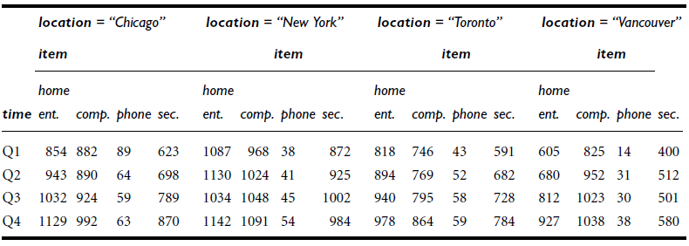
Table: A 3-D view of sales data according to the dimensions time, item, and location. The measure displayed is dollars sold (in thousands).

Slide 72
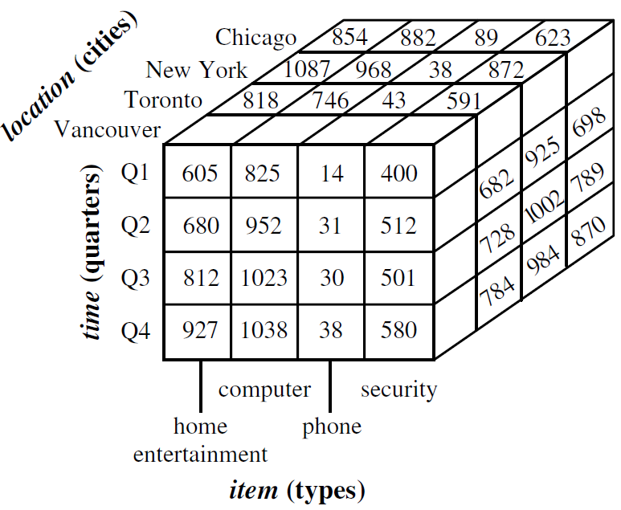
Figure: A 3-D data cube representation of the data in the table above, according to the dimensions time, item, and location. The measure displayed is dollars sold (in thousands).

Slide 73
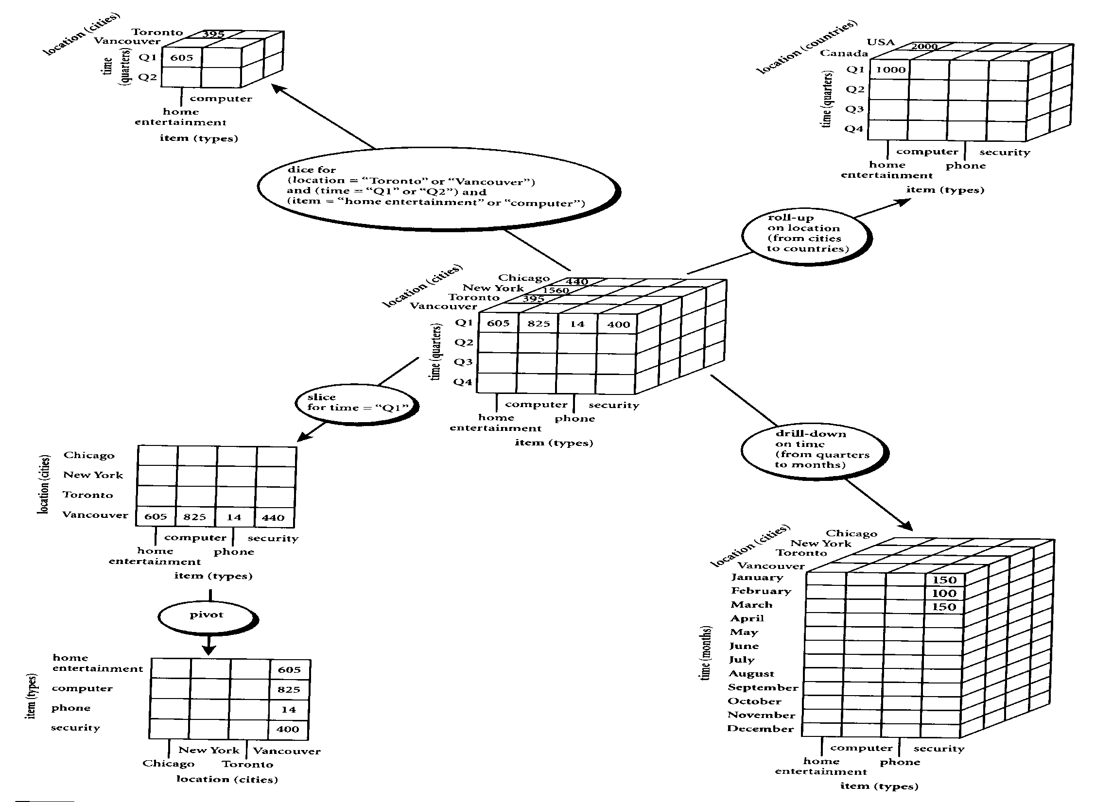
Figure: Examples of typical OLAP operations on multidimensional data

Slide 74
Roll-up and Drill-down
The roll-up operation performs aggregation on a data cube, either by climbing up a concept hierarchy for a dimension or by dimension reduction such that one or more dimensions are removed from the given cube.
Drill-down is the reverse of roll-up. It navigates from less detailed data to more detailed data. Drill-down can be realized by either stepping down a concept hierarchy for a dimension or introducing additional dimensions.

Slide 75
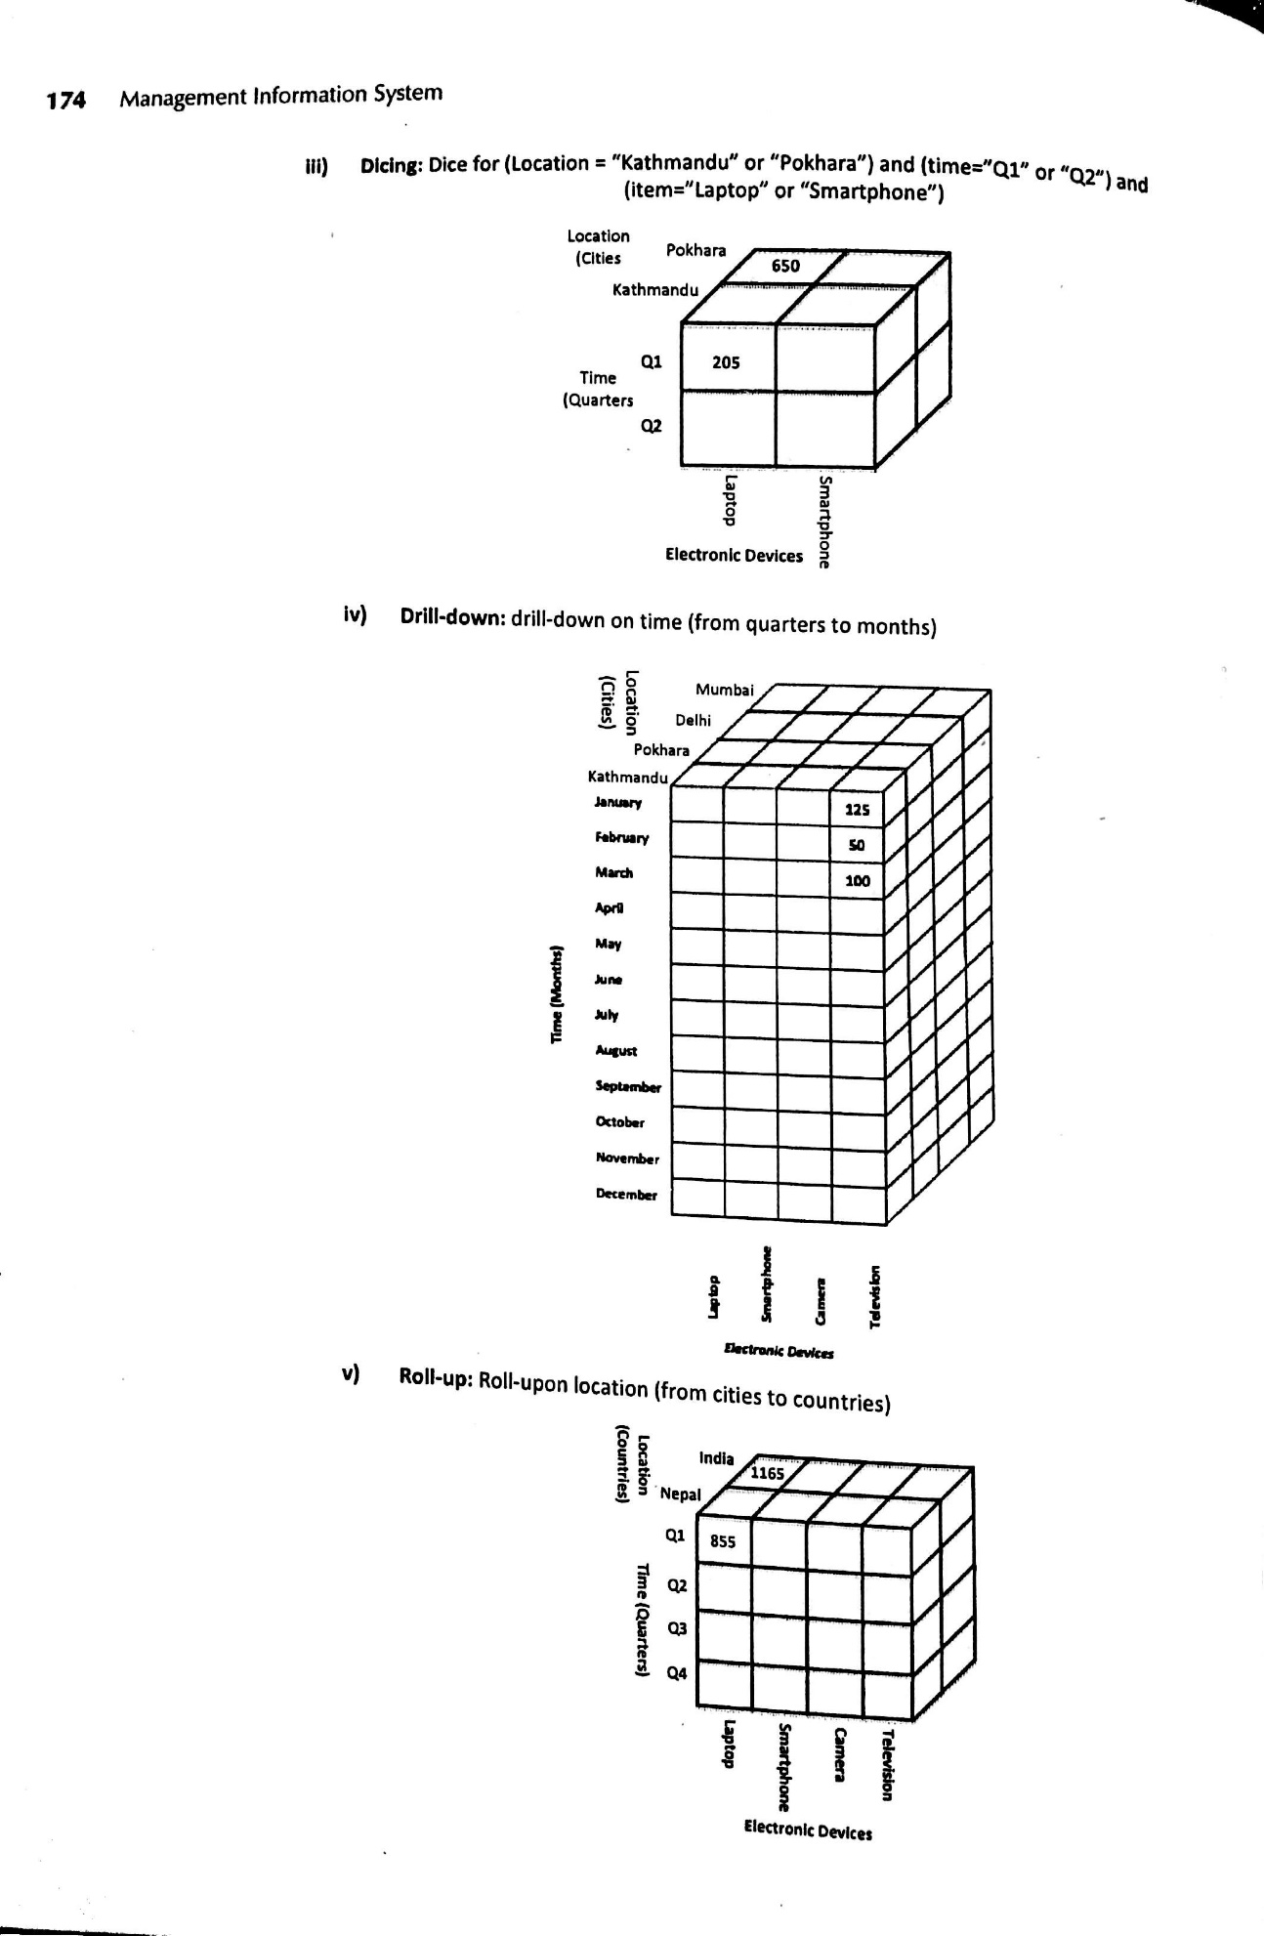
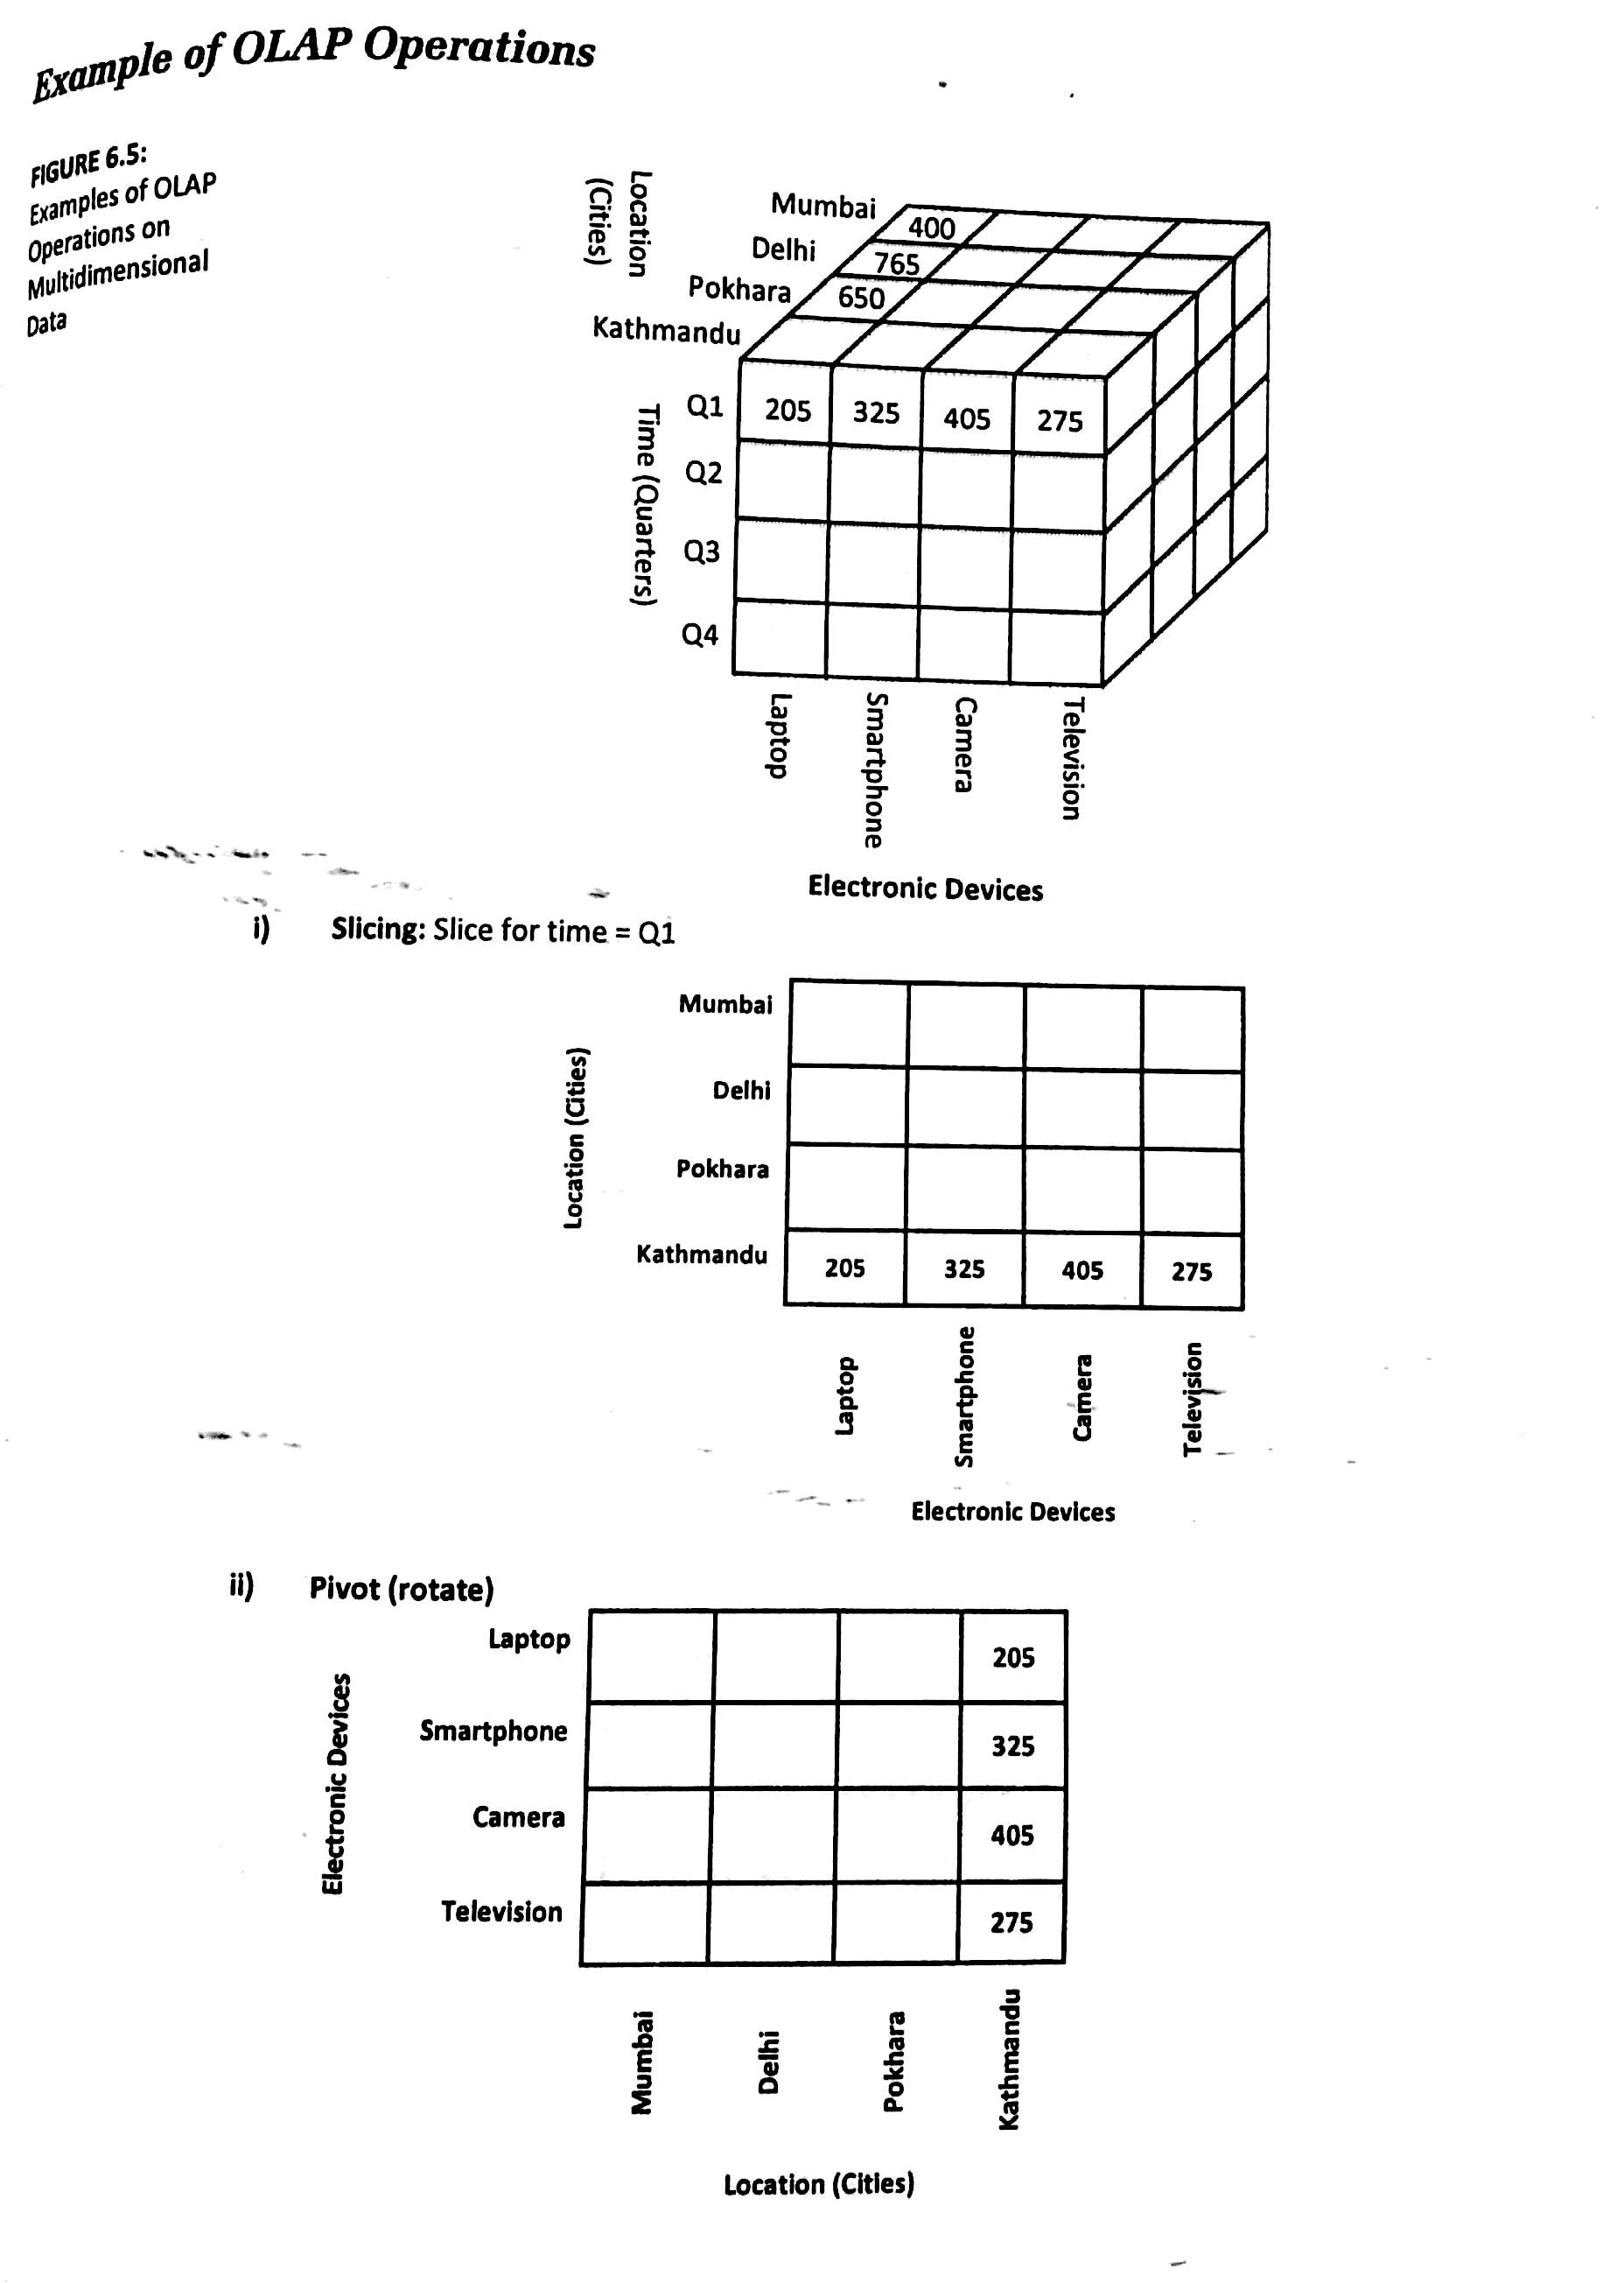

Slide 79
Drill Down Example

Slide 80
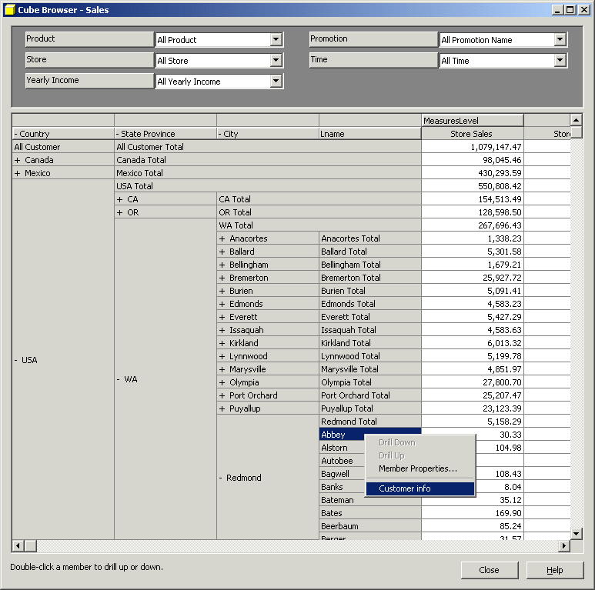
Sample OLAP Drill down online report

Slide 81
Figure:
Example of drill-down
Quarterly Auto Sales Summary
Region
Northeast
Southeast
Central
Northwest
Southwest
Units Sold
Revenue
Quarterly Auto Sales Summary
Region
Northeast
Southeast
State
Maine
New York
Massachusetts
Florida
Georgia
Virginia
Units Sold
Revenue

Slide 82
Figure:
Example of Roll up
Quarterly Auto Sales Summary
Region
Northeast
Southeast
State
Maine
New York
Massachusetts
Florida
Georgia
Virginia
Units Sold
Revenue
Quarterly Auto Sales Summary
Region
Northeast
Southeast
Central
Northwest
Southwest
Units Sold
Revenue

Slide 83
Slice and Dice
The slice operation performs a selection on one dimension of the given cube, resulting in a sub cube.
The dice operation defines a sub cube by performing a selection on two or more dimensions.

Slide 86


Slide 88
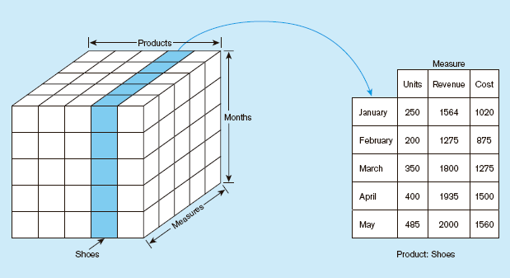
Figure: Slicing a data cube

Slide 89
Slicing (above) and dicing (below) a cube

Slide 90
Rotation (Pivot Table)
Product
Product
Region
Time
Time
Region

Slide 91
Pivot

Slide 92
Example of Rotation (Pivot Table)

Slide 93


Slide 94

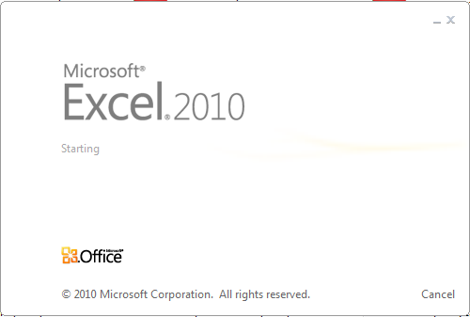




Data Mining Tools

Slide 95
Thank you !!!

